Slide 1


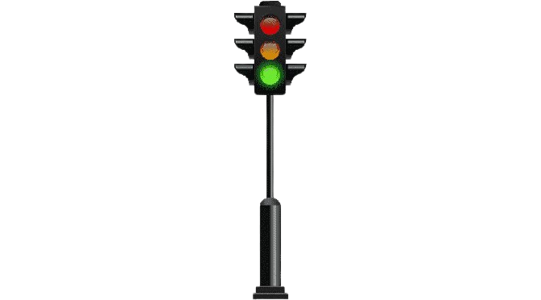
-MASTER OF COMPUTER APPLICATION
TRAFFIC LIGHT USING ARDUINO UNO
- Guide: VARSHA JJ
AZMAL BABU.B (23205008)
ADHITHYAN.K (23205003)
PRAKALATHAN.G (232050036)
MOHAMED IRFAN.J (23205030)

Slide 2
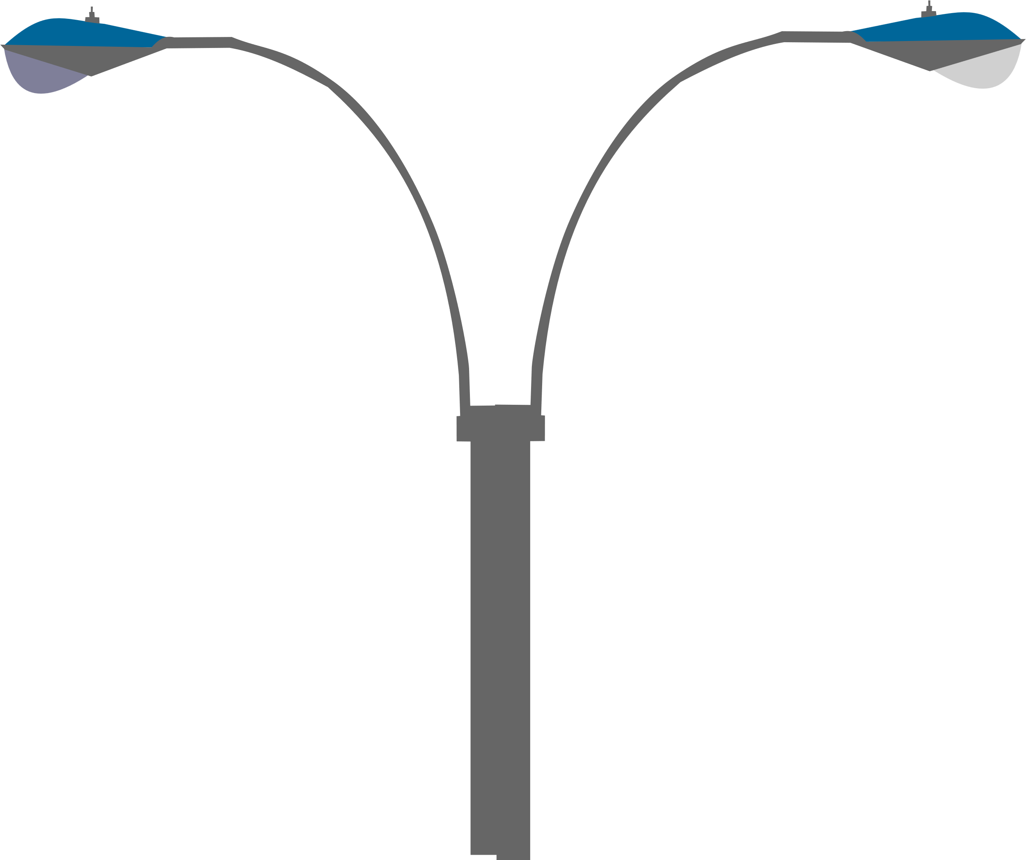


TABLE OF CONTENTS
01.
INTRODUCTION
02.
METHODOLOGY
03.
PROPOSED SYSTEM
04.
LITERATURE REVIEW(existing system)

Slide 3

OBJECTIVE
The primary objective of this project is to create a functioning traffic light system that simulates the basic operation of a real-world traffic light. The system will sequentially control three LEDs to mimic the red, yellow, and green lights, implementing the standard traffic light sequence.
With the integration of artificial intelligence, sensors, and machine learning algorithms, traffic management will be revolutionised.We can expect to see a shift towards a more seamless and connected traffic system with fewer accidents and less time wasted sitting in traffic.

Slide 4


INTRODUCTION
Traffic lights are essential components of modern road systems, controlling the flow of traffic and ensuring safety at intersections. Building a traffic light system with an Arduino Uno offers a practical way to explore concepts in electronics and programming.

Slide 5
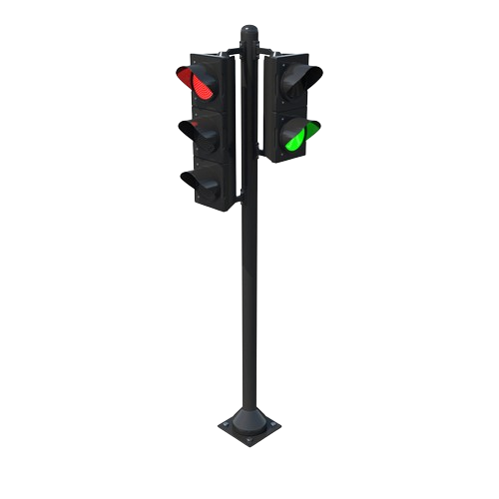

METHODOLOGY
Software Components
Hardware Components
Traffic Light Sequence Management:
Control the switching of the traffic lights (red, yellow, green) based on a predefined time interval.
Pedestrian Button Handling:
Detect when the pedestrian button is pressed and trigger a pedestrian crossing sequence.
Optional Buzzer Integration:
Use a buzzer to provide an auditory signal when it's safe for pedestrians to cross.
Arduino Uno: Microcontroller board to control the system.
LEDs: Three LEDs representing the traffic light signals (red, yellow, green).
Resistors: 220-ohm resistors to limit current to the LEDs.
Breadboard: For assembling the circuit.
Jumper Wires: For making connections between components.

Slide 6


PROPOSED SYSEM
Setup:
Define the pin numbers for the LEDs.
Initialize the LED pins as outputs in the setup() function.
Loop:
Turn on the green LED, wait for 5 seconds (5000 ms), then turn it off.
Turn on the yellow LED, wait for 2 seconds (2000 ms), then turn it off.
Turn on the red LED, wait for 5 seconds (5000 ms), then turn it off.
Repeat the cycle.

Slide 7




EXISTING SYSTEM
Evaluation of Current Lighting Infrastructure
system's AI algorithms analyse real-time data!
Design and Installation of New Lighting Systems
Implementation of Energy-Efficient Technologies
dynamic lane management, and efficient vehicle routing!
enabling proactive adjustments to traffic signals!

Slide 8
CONCLUSION
Building a traffic light system with an Arduino Uno is an enriching project that solidifies fundamental concepts in electronics and programming. It opens doors to numerous enhancements and variations, making it a versatile and scalable learning experience. Through this project, one gains practical skills that are foundational for more advanced projects and real-world applications in automation and control systems.

Slide 9
REFERENCE
Arduino Official Website:
The official Arduino website (https://www.arduino.cc/) provides comprehensive documentation, tutorials, and examples for getting started with Arduino boards and projects.
Arduino Workshop: A Hands-On Introduction with 65 Projects" by John Boxall
https://youtu.be/u6ilYC7LeKQ?si=ggovgvHmPdWnfhSM

Slide 10
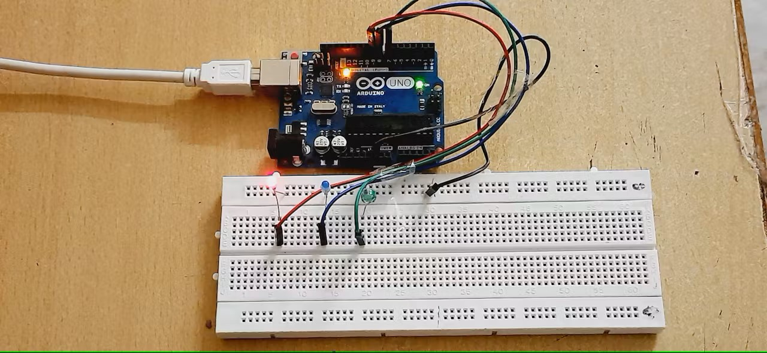
OUTPUT:

Slide 11
OUTPUT EXPLONATION:
Place the LEDs on the Breadboard:
Insert the Red LED into the breadboard.
Insert the Yellow LED into the breadboard.
Insert the Green LED into the breadboard.
Connect the Resistors:
Connect a 220 ohm resistor to the cathode (short leg) of each LED. The other end of each resistor should be connected to the ground rail on the breadboard.
Connect the LEDs to Arduino Pins:
Connect the anode (long leg) of the Red LED to digital pin 13 on the Arduino.
Connect the anode of the Yellow LED to digital pin 12.
Connect the anode of the Green LED to digital pin 11.
Connect Ground:
Connect the ground rail on the breadboard to one of the GND pins on the Arduino.

Slide 12
THANK YOU!

